Slide 1







Applying Discrete Global Grid Systems (DGGS) across diverse data jurisdictions.
http://locationindex.org/
Joseph Bell, Geoscience Australia

Slide 2
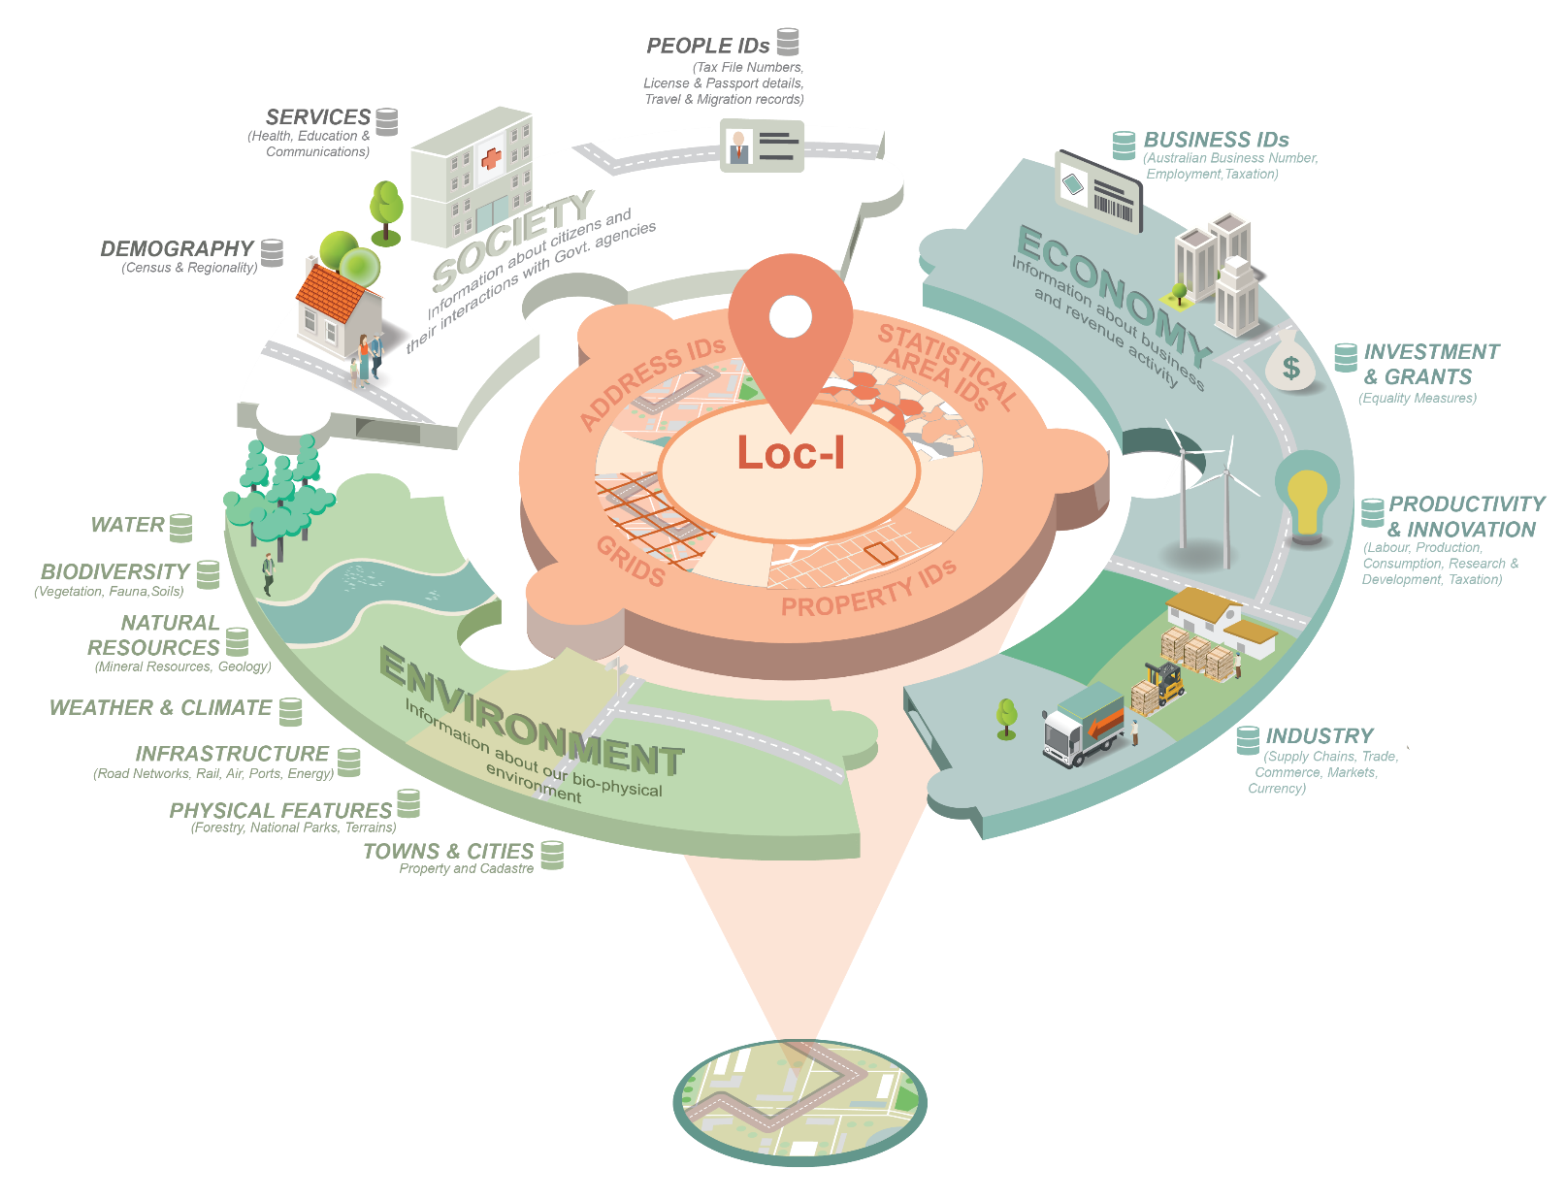

Slide 3
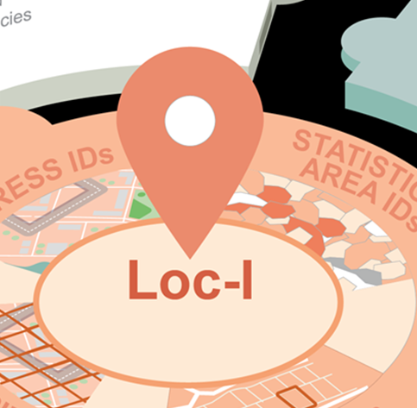
Different ways of describing Location
Descriptive – e.g. semantic links through place name descriptions/associations
Position & Geometry – e.g. latitude, longitude and topological relationships through classic GIS methods
Indexing – e.g. DGGS or ASGS polygons
DGGS (Discrete Global Grid Systems )

Slide 4
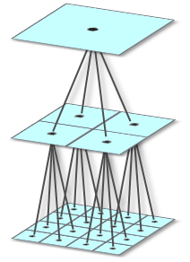
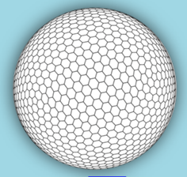
Discrete Global Grid Systems (DGGS) as defined by the OGC
an earth reference system – whole Earth
hierarchical – fixed relationships between parents & child cells
equal area - cells of same resolution have equal area
tessellation of the Earth to partition and address the entire globe

Slide 5





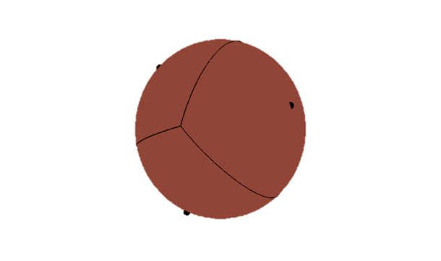
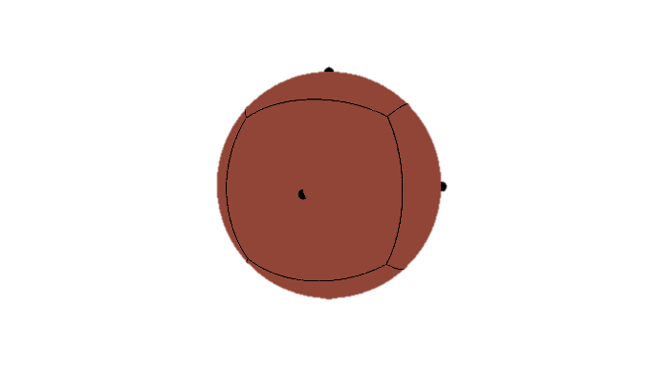
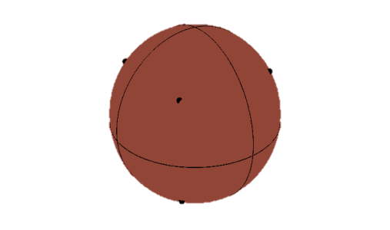
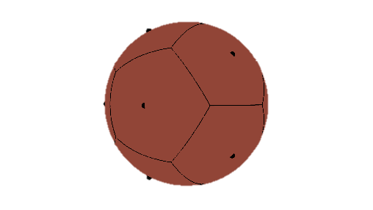
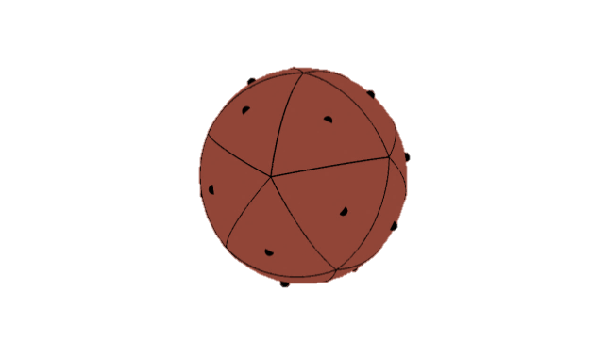
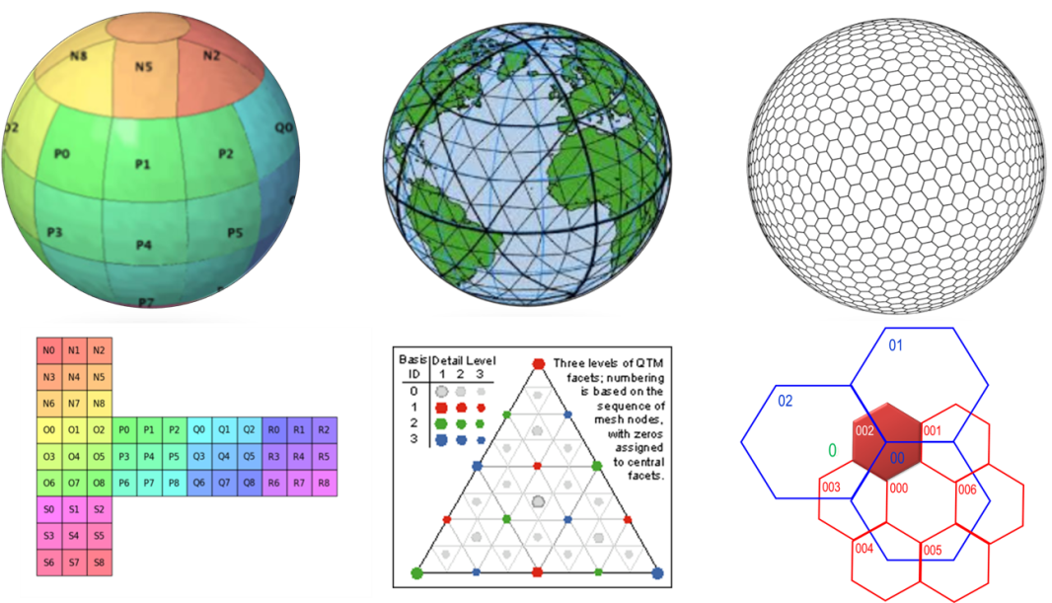
Several DGGS shapes but very similar principles
Equal Area
Tessellations
of the
Earth’s Surface
Model
Tetrahedron
Cube
Octahedron
Dodecahedron
Icosahedron
Simple cell
Types:
Rectangular
Triangular
Hexagonal

Slide 6
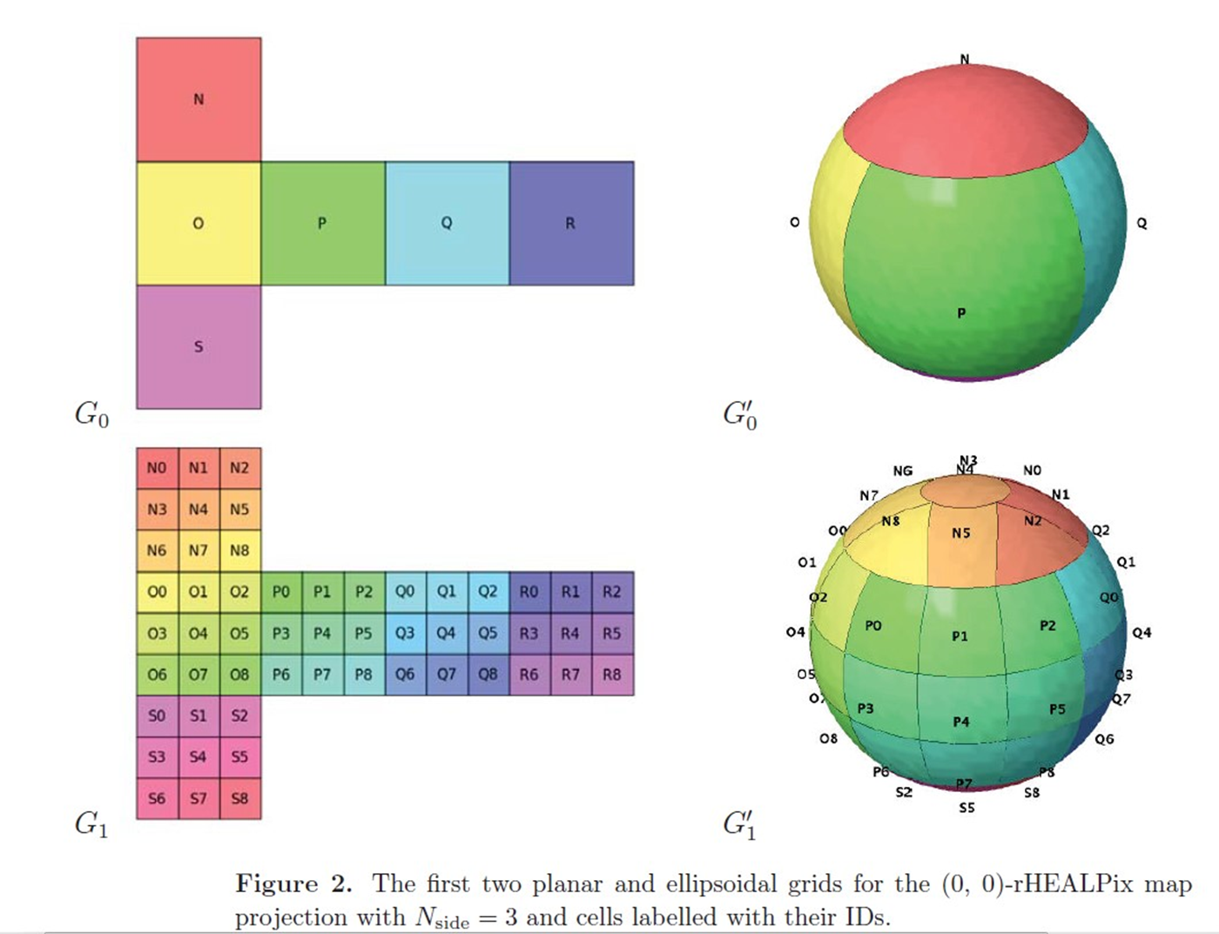
AusPIX Cubic model
Gibb, R.G., 2016, “The rHealPIX Discrete Global Grid System”

Slide 7
Advantages of a DGGS (AusPIX) implementation
Regular and unchanging
Ellipsoidal – no map transforms needed - excellent for continental scale
Worldwide application – not a local grid
Polar regions catered for.
Can define location to degree of resolution required eg big cells for sensitive data, small cells for high resolution.
Uncertainty can be expressed by the size of the cell
Can be used as a location index.
Ability to fuse data from multiple projections using DGGS as the consistent reference frame.

Slide 8
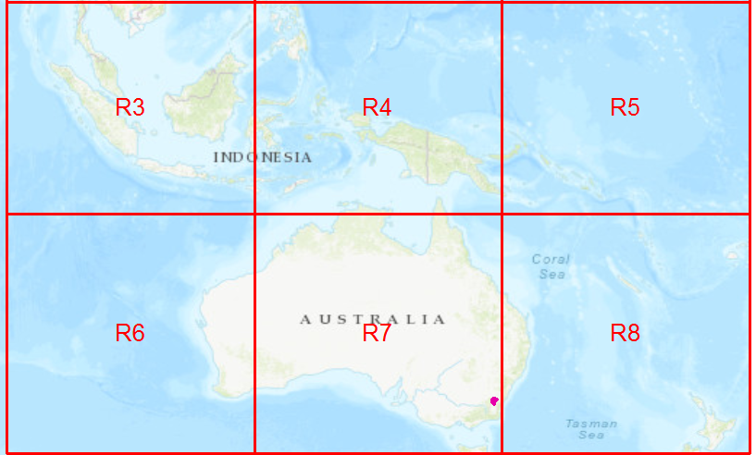

Australian Region
R cells

Slide 9
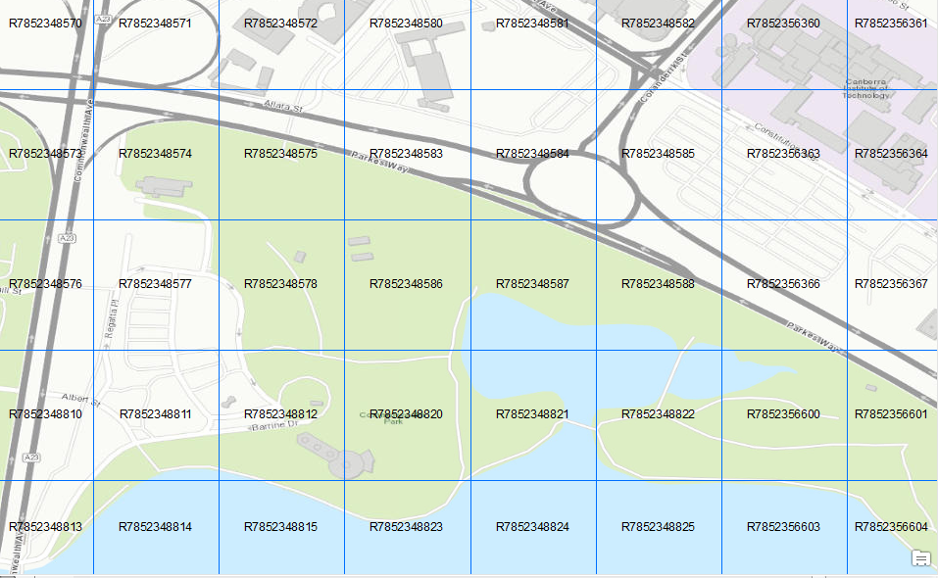
DGGS grid over a small part of Canberra. Cell are approximately 160m across. (DGGS level 10)

Slide 10
Implementing DGGS
pn:VIC15650 pn:hasPlaceName "LOY YANG A POWER STATION" .
pn:VIC15650 pn:FeatureClassification "Built Structures" .
pn:VIC15650 pn:latitude "-38.2540278" .
pn:VIC15650 pn:longitude "146.5743056" .
pn:VIC15650 pn:State "Victoria" .
pn:VIC15650 pn:DGGSrHealpix "R787222356873"
DGGS tag
1. DGGS engine (eg rHealPIX, AusPIX)
2. Tagging existing data with DGGS attributes
Points eg. addresses, place names Point (149.0766452, -35.38421273) = R7852374756
Lines eg. roads, rivers
Polygons eg. Statistical Areas, National Parks, Cadastre, disaster areas
Rasters eg. satellite imagery
http://github.com/GeoscienceAustralia/AusPIX_DGGS

Slide 11
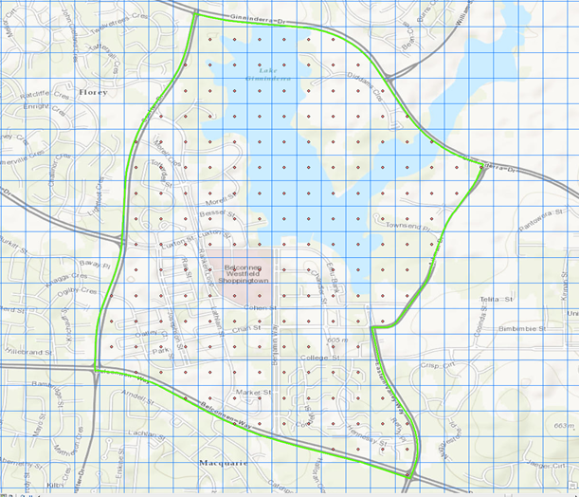
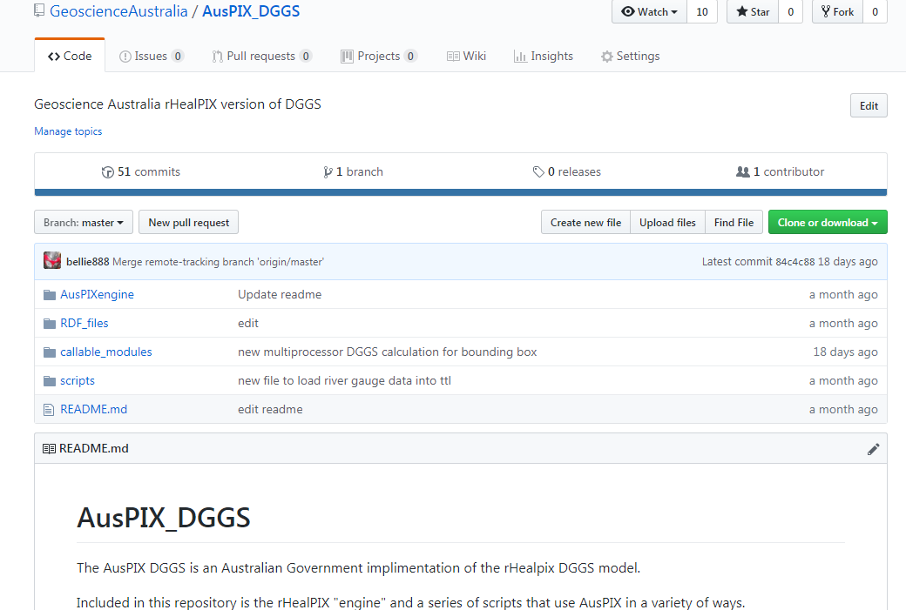
Tools (under development)
DGGS to shapefile – visualisation, verification
Github repository
Figure 3; Belconnen SA2 with level 10 (140m) DGGS Polygons and centroids.
http://github.com/GeoscienceAustralia/AusPIX_DGGS

Slide 12
Future work:
On the fly DGGS tagging (compared to imbedded tagging)
Complete DGGS tagging script for lines and rasters
Methods to walk between DGGS instances and types
User interfaces (UI’s) to integrate data based on DGGS taggs
Develop output types, eg csv, shapefiles, RDF triple-store etc

Slide 13
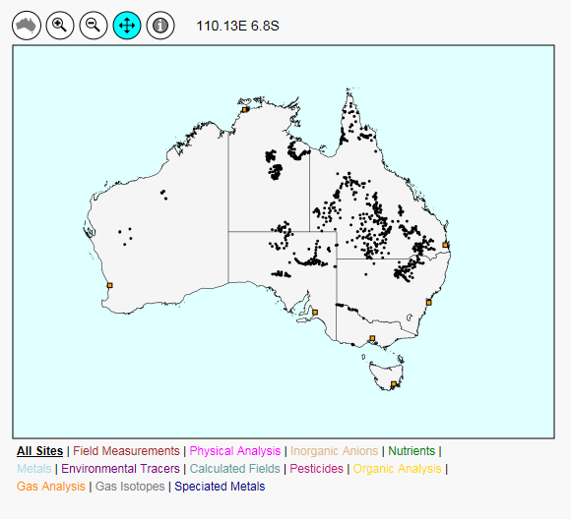
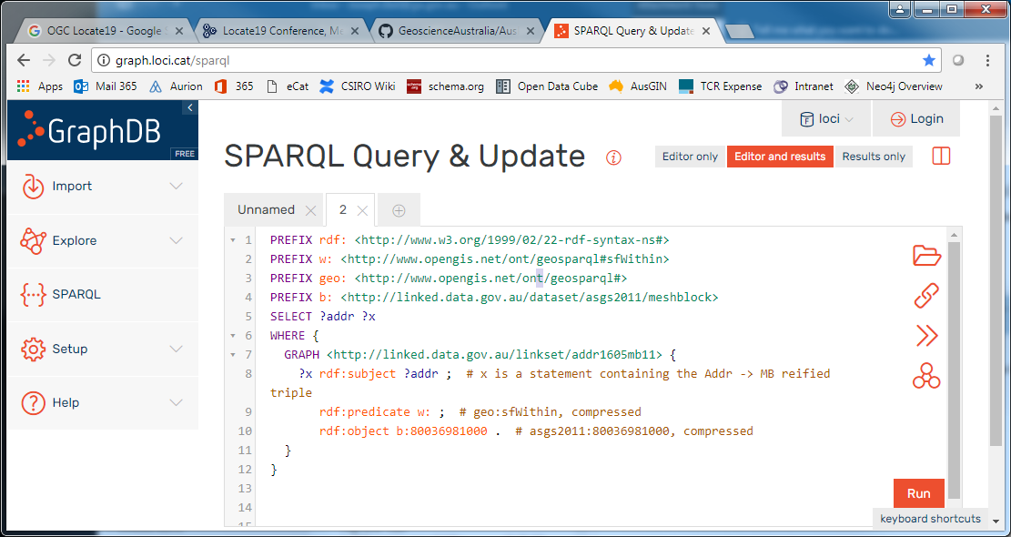
Implementing Data integration
Integrate data using the DGGS tags
Simple network of methods to suit different workflows
1) Simple UI based – less flexible
2) Complex – special tools based – but flexible, eg Sparql queries in triple stores

Slide 14
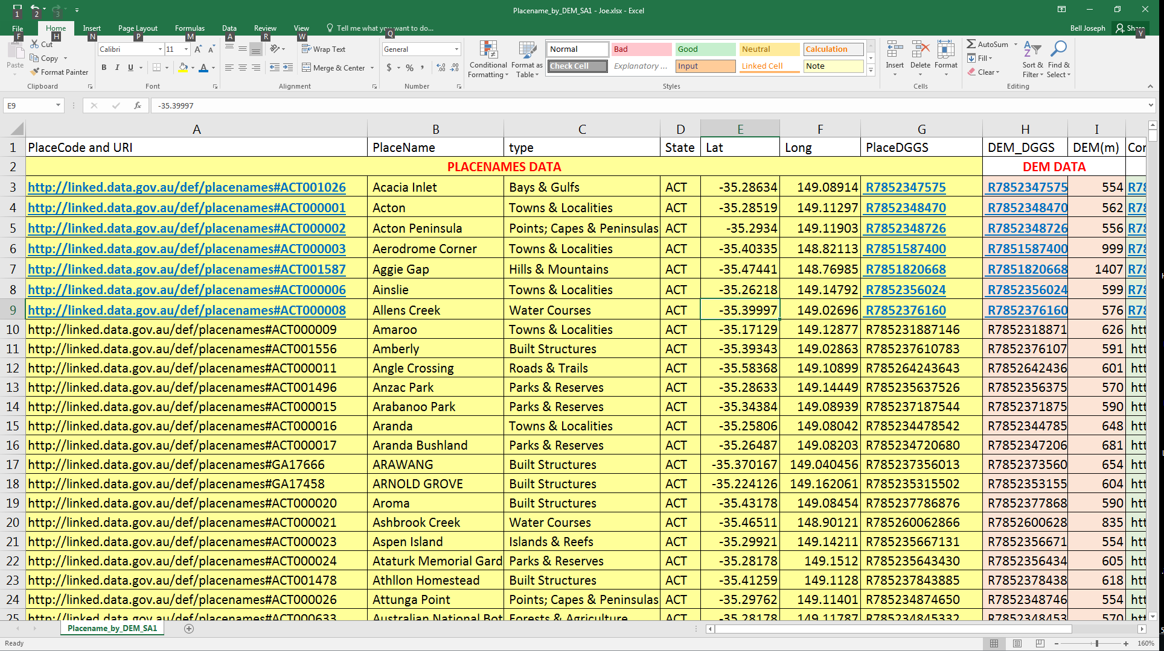
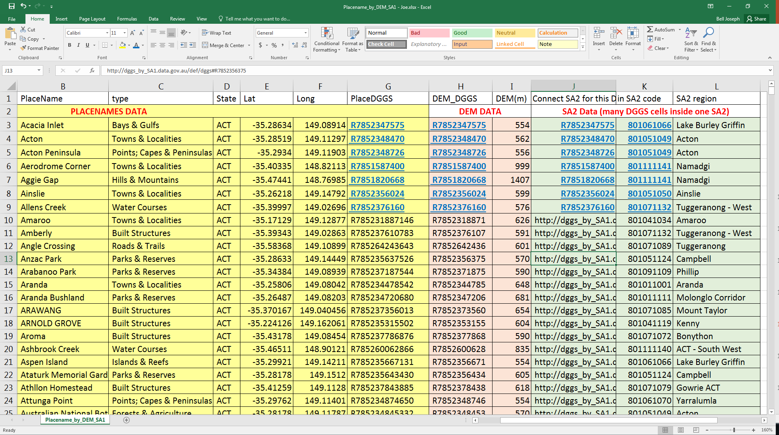
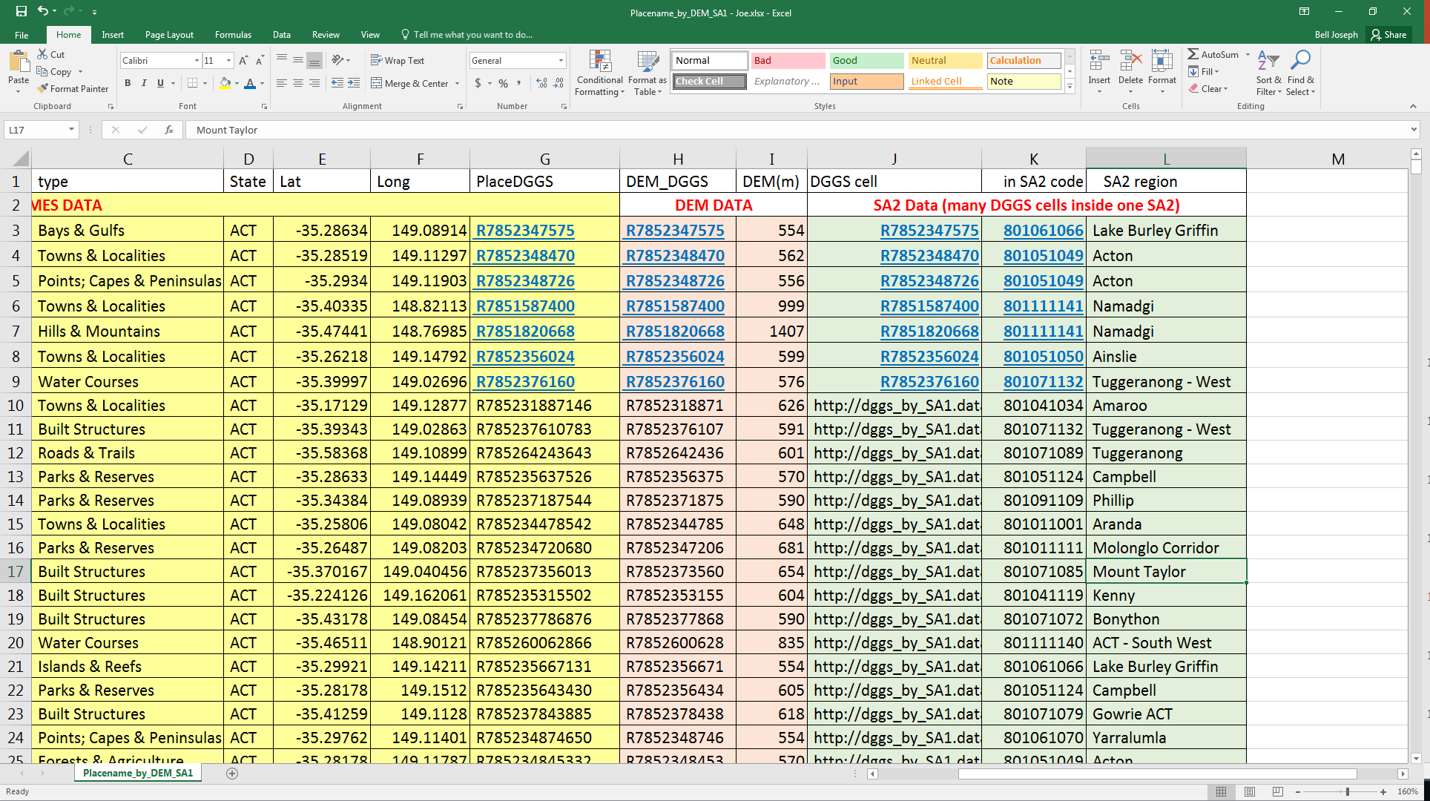
Connecting data using DGGS as a Location index
Place Names
“Acacia Inlet” is at an elevation of 554m and is located in
SA2 code 801061066
Digital Elevation Model
Australian Bureau of Statistics SA2
All hyperlinks to landing pages that include map and attributes for those features.

Slide 15
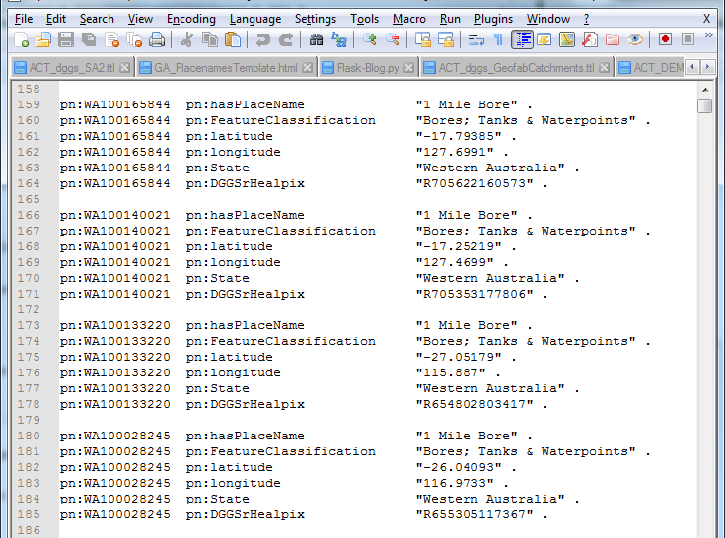
DGGS tagged triple store
Triple-store that connects Place Names to their DGGS reference tags. (draft)

Slide 16
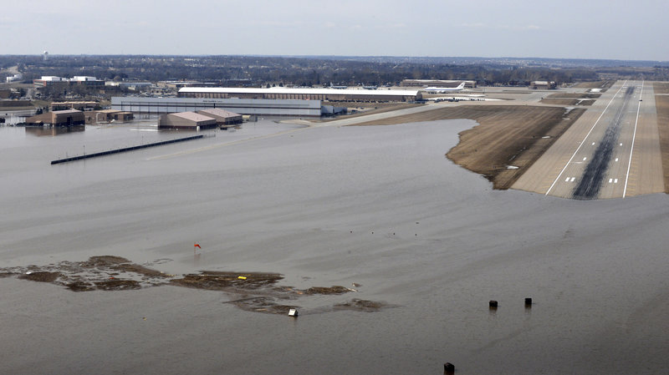
Start to answer questions like:
For a flood disaster:
What are the Location Index cells that represent that area [e.g. DGGS]?
Where are the low areas in this region? [DEM]
How many people could be affected, how many addresses? [ ASGS Mesh Blocks]
What government support might be needed (population statistics, age, economics) [DHS, DSS data]
What is the impact on agriculture/industry [economic and productivity data]
What assets (natural or economic) are in the area [Dept Ag, Dept Environment]
What support structures are nearby (Hospitals, Fuel stations etc)
Tech. Sgt. Rachelle Blake/U.S. Air Force via AP

